Slide 1
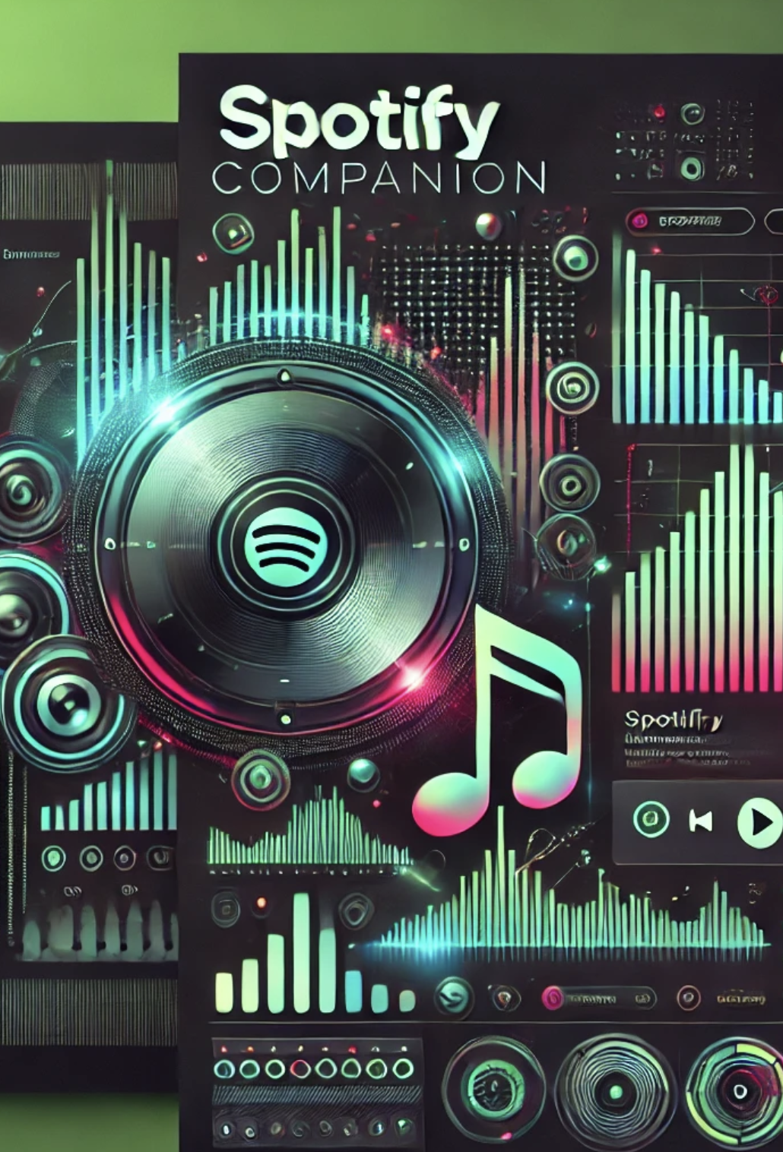

CSC207 Final Project Spotify Companion Fall 2024
Group 99
Yanki Cer Dimitrios Gkiokmema Quinn Reynolds Ksenia Tkaczyk Yicheng Wang

Slide 2
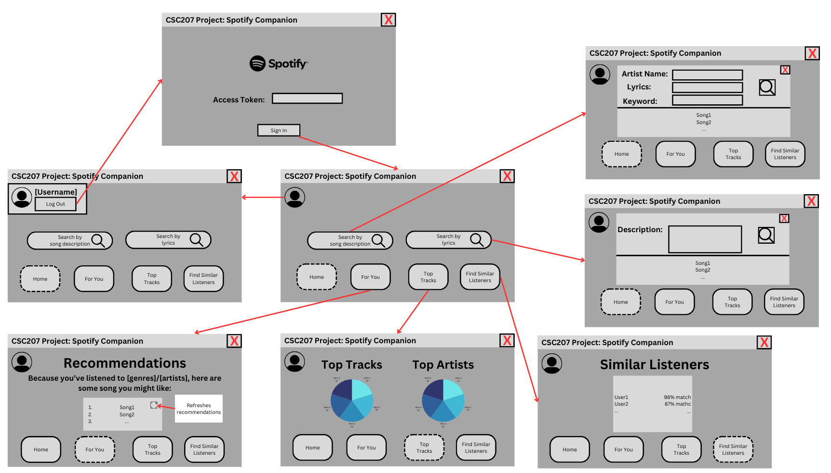
Specification
An extension of a user’s Spotify account:
Visualize the user's listening patterns
Recommend songs
Search songs by artist and keyword
Find users with similar preferences.

Slide 3
API Usage
Spotify:
Accessing user listening history to get their top tracks and artists
Search tracks by providing artist and keyword
Microsoft Azure:
Providing recommendations based on a list of songs the user listened to
Given a general or detailed description, output songs related to the description.

Slide 4
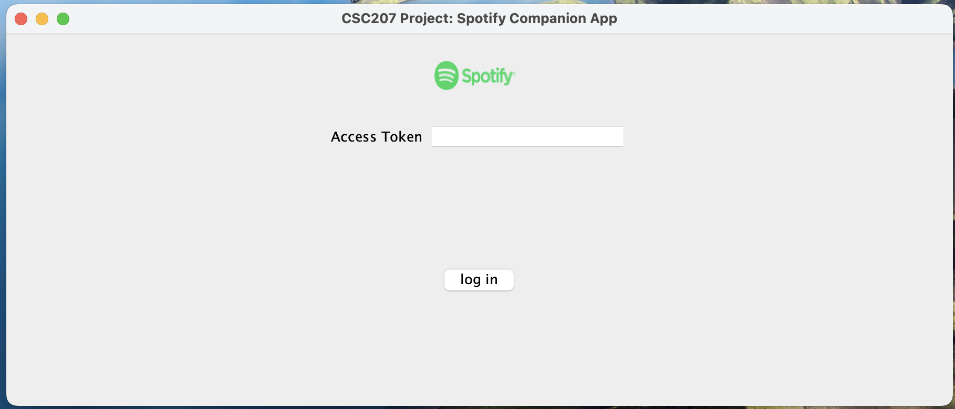
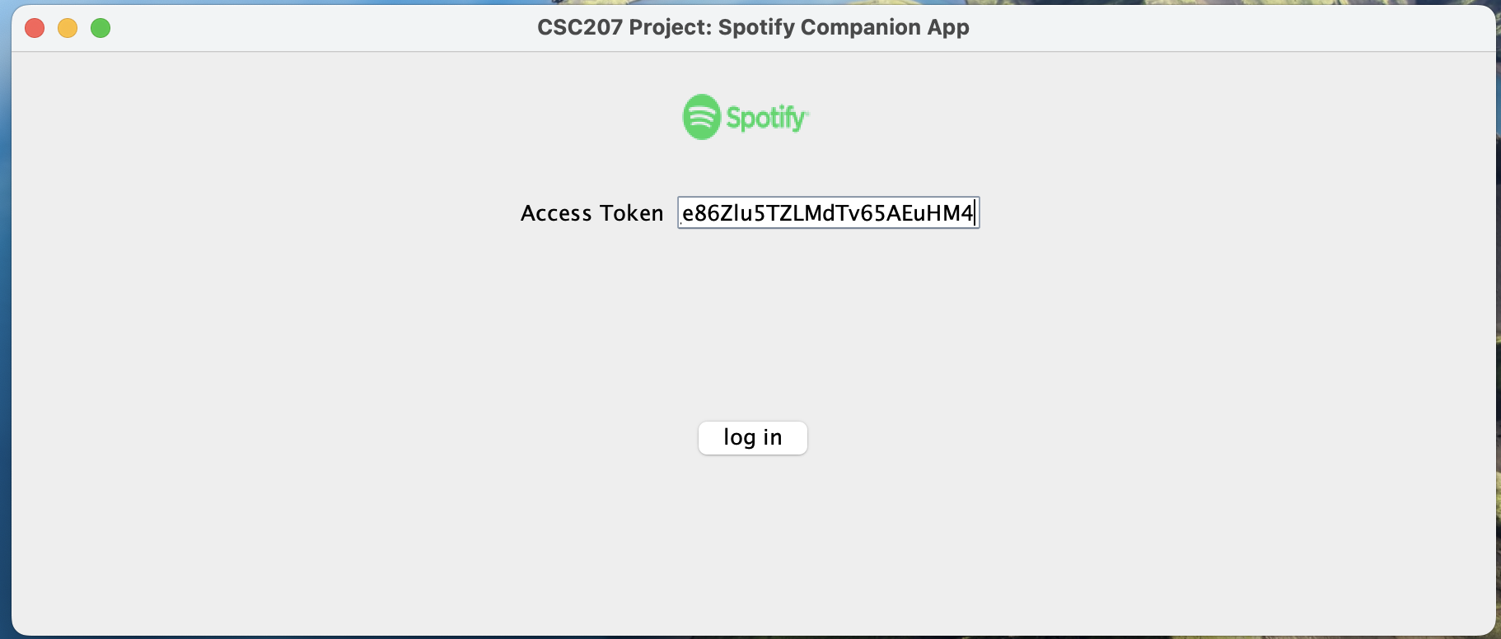
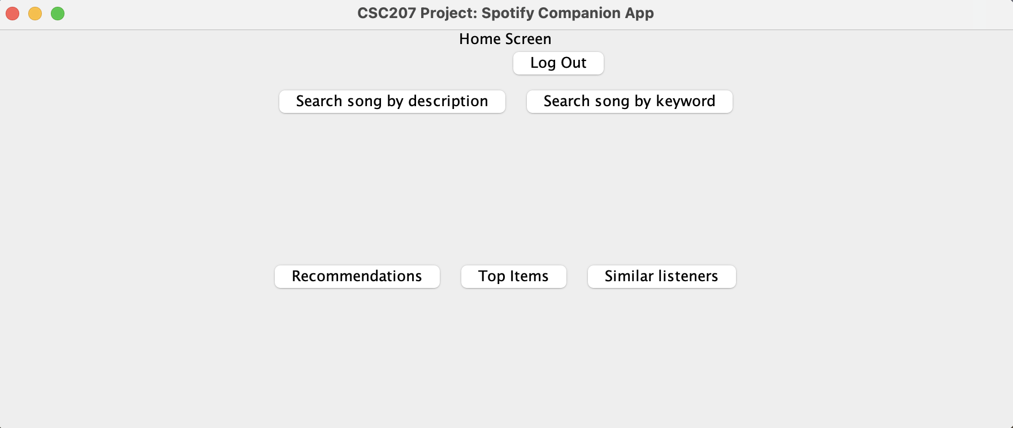
Login / Logout
User story: John can log in with an access token and log out.

Slide 5
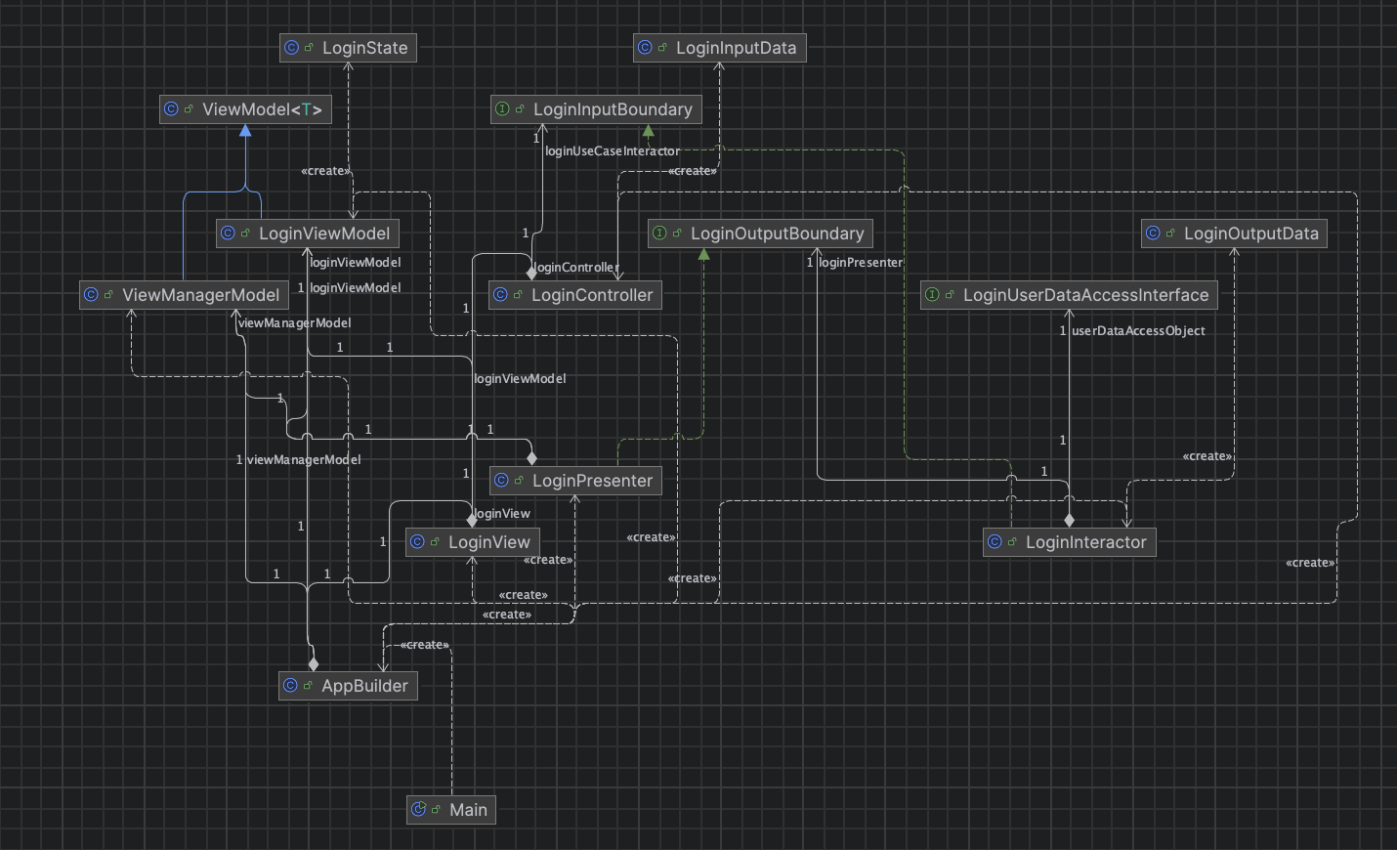
UML (log in)

Slide 6
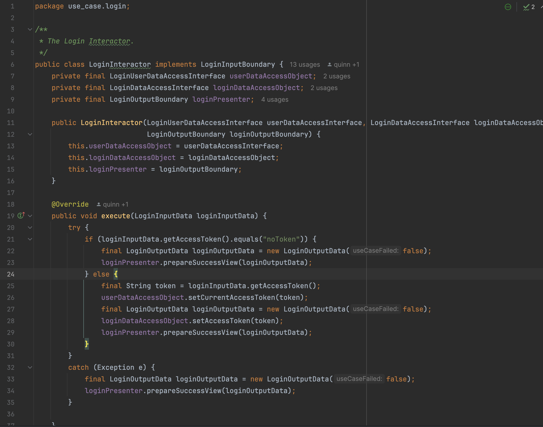
Log in interactor

Slide 7
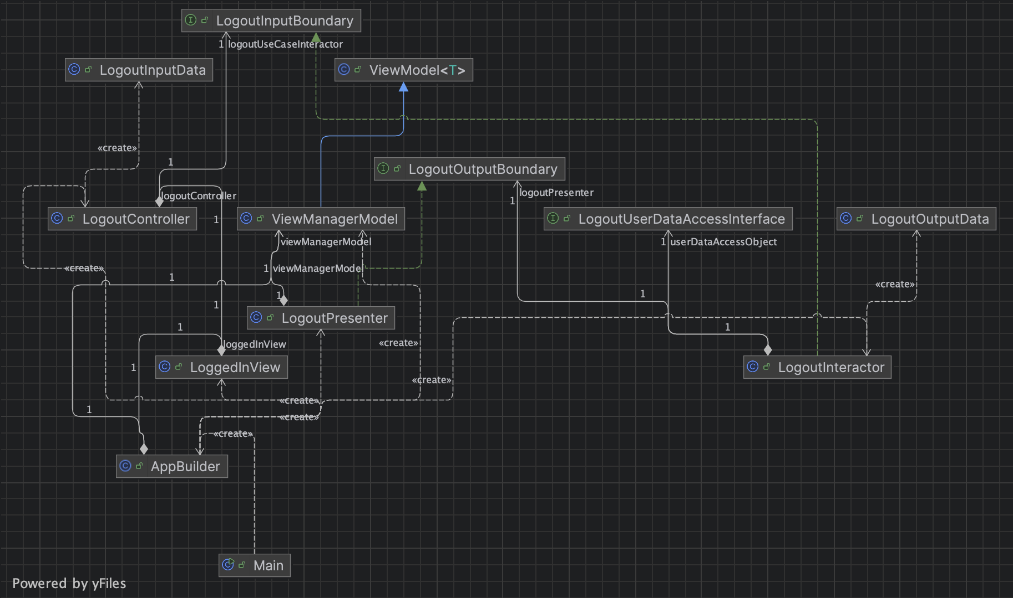
UML (log out)

Slide 8
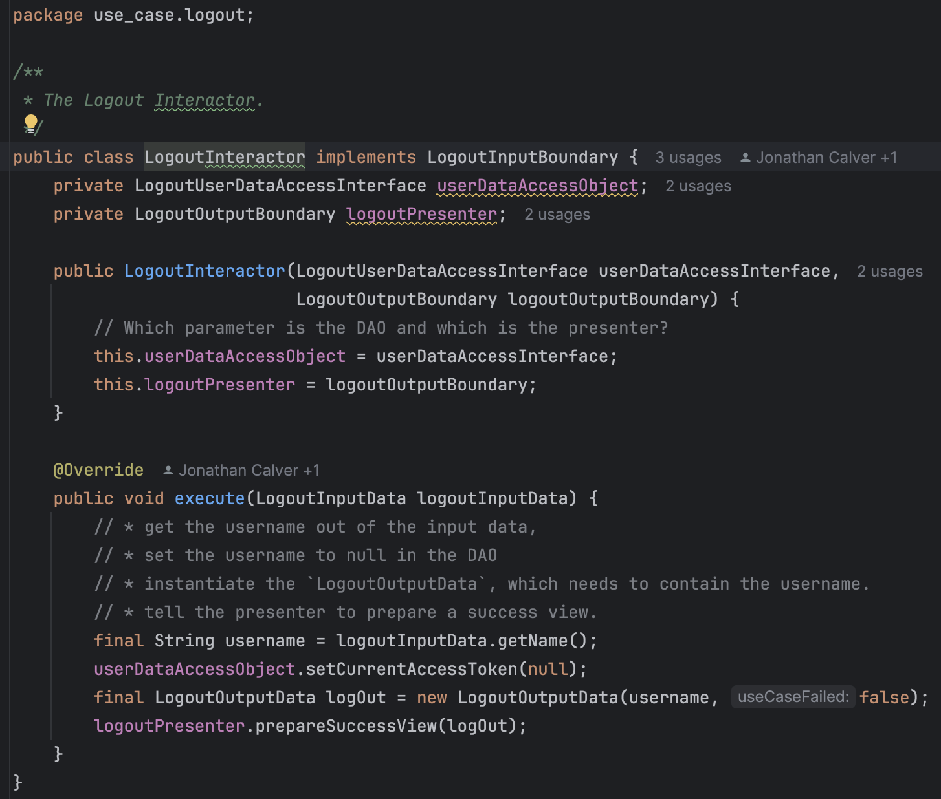
Log out interactor

Slide 9
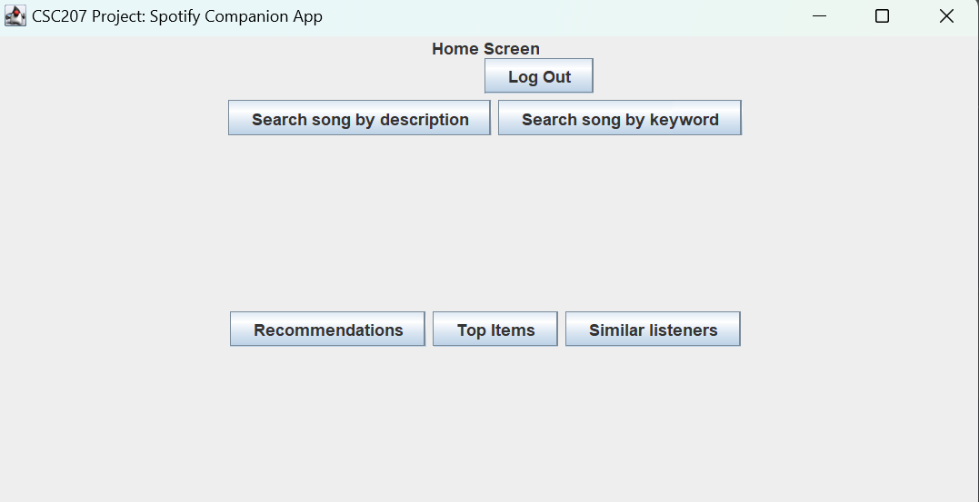
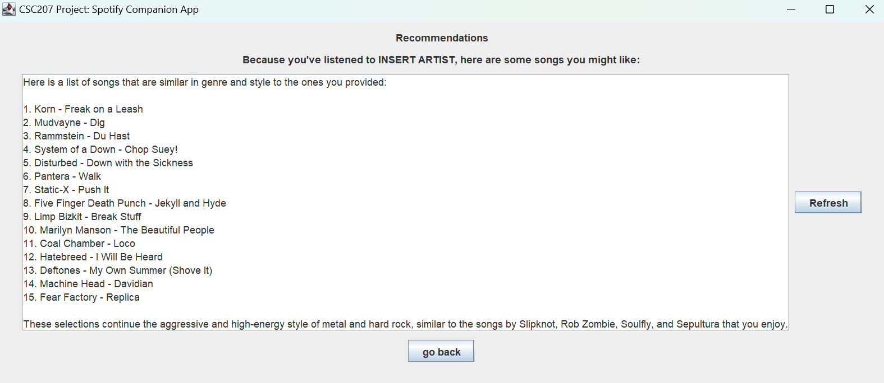
Recommendations
User Story: John wants to get song recommendations based on his music preferences.

Slide 10
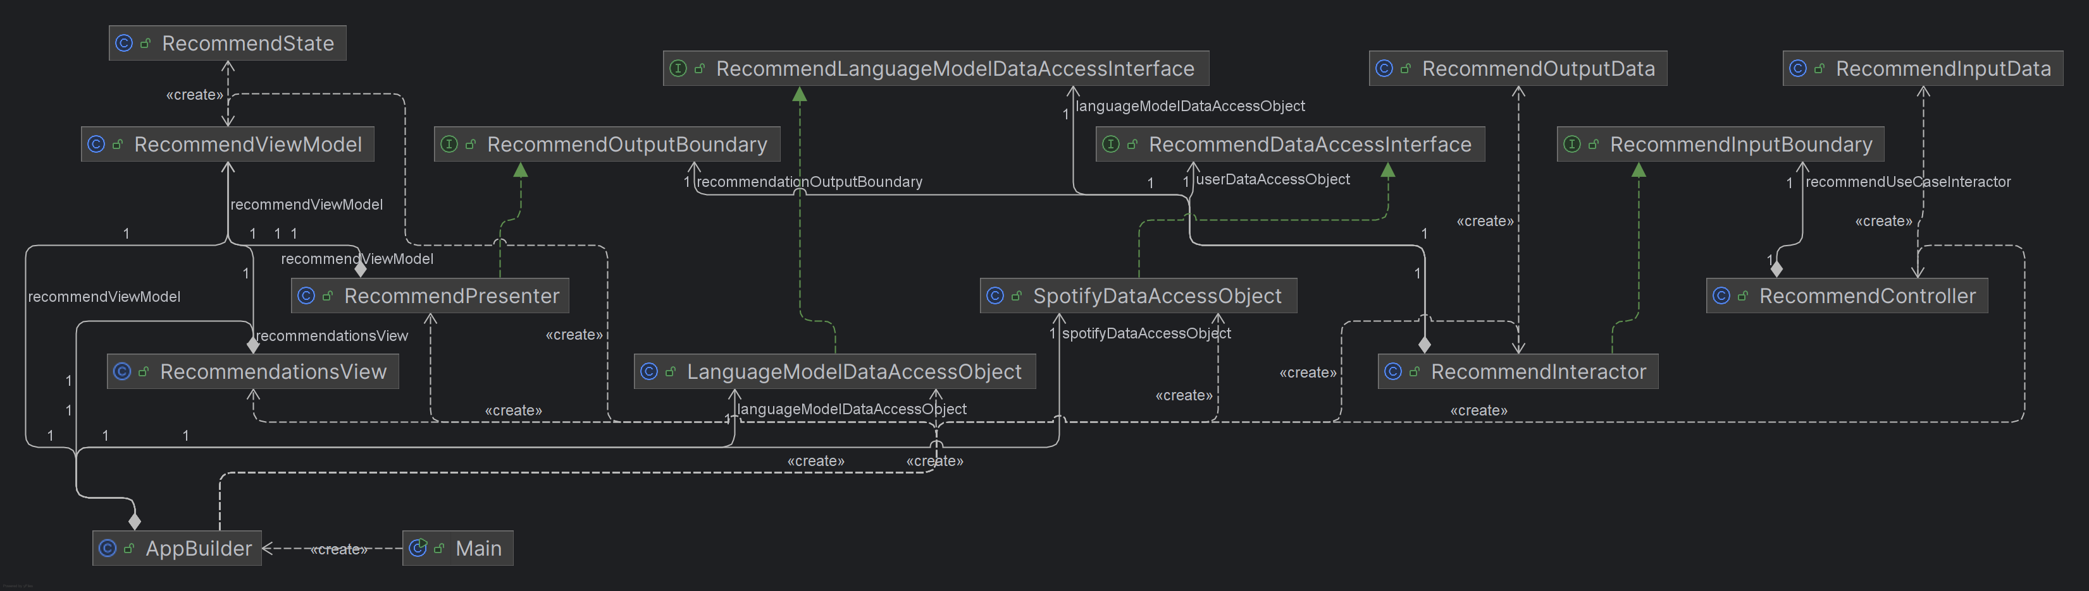
UML

Slide 11
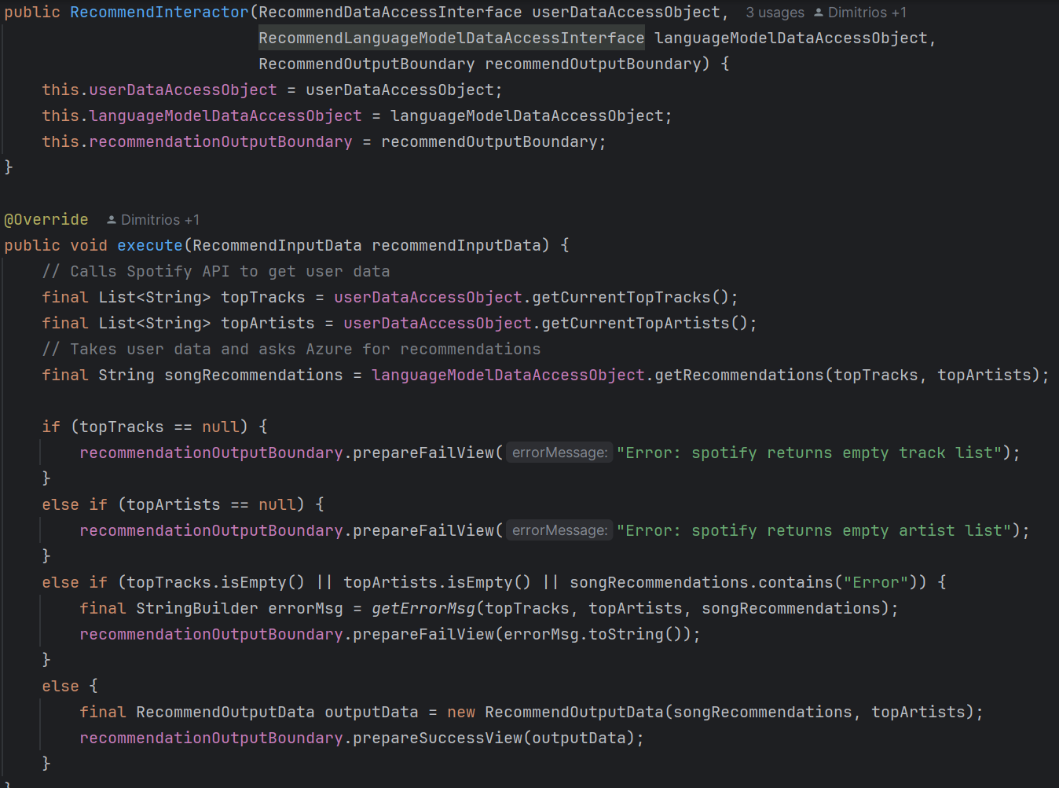
Recommend Interactor

Slide 12
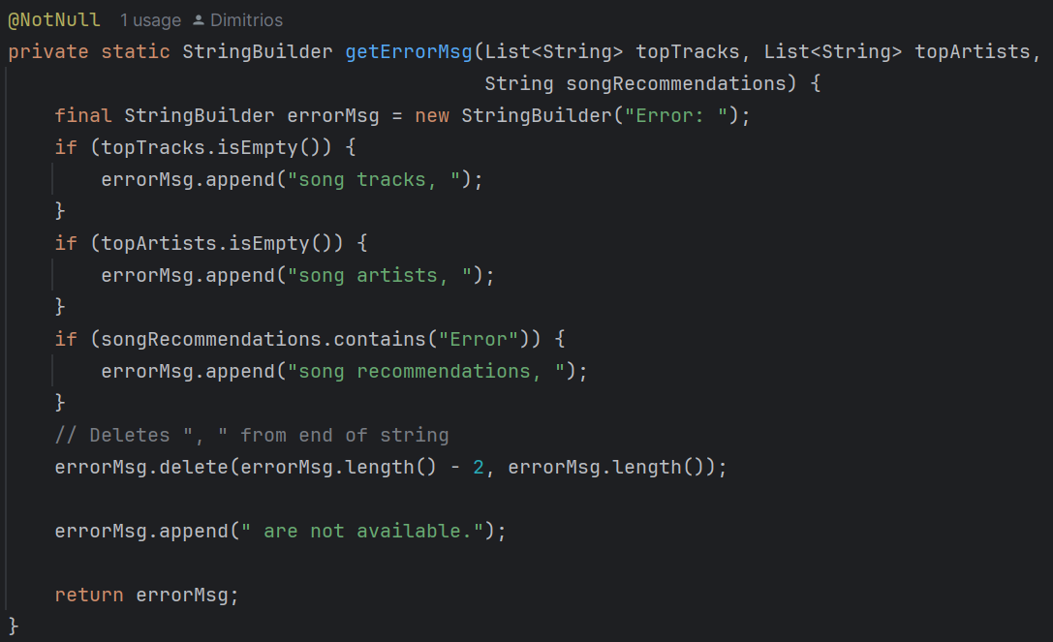
Recommend Interactor

Slide 13
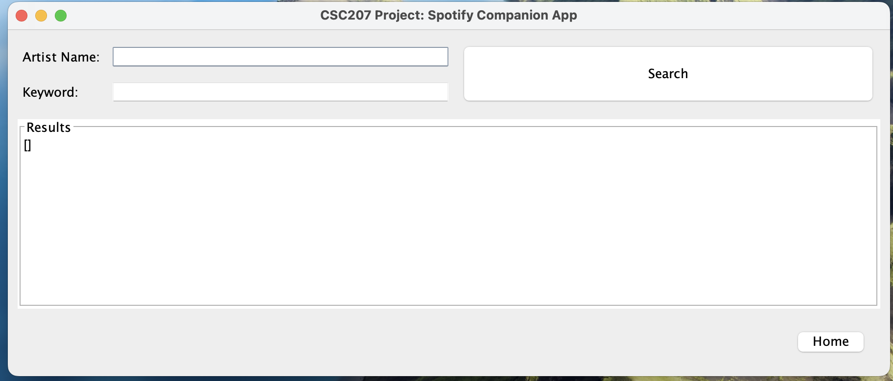
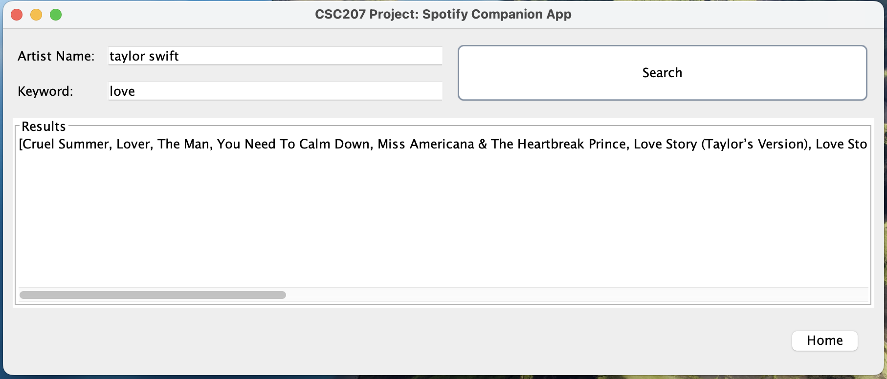
Keyword Search
User story: the user can search for songs by artist and the keyword they enter.

Slide 14
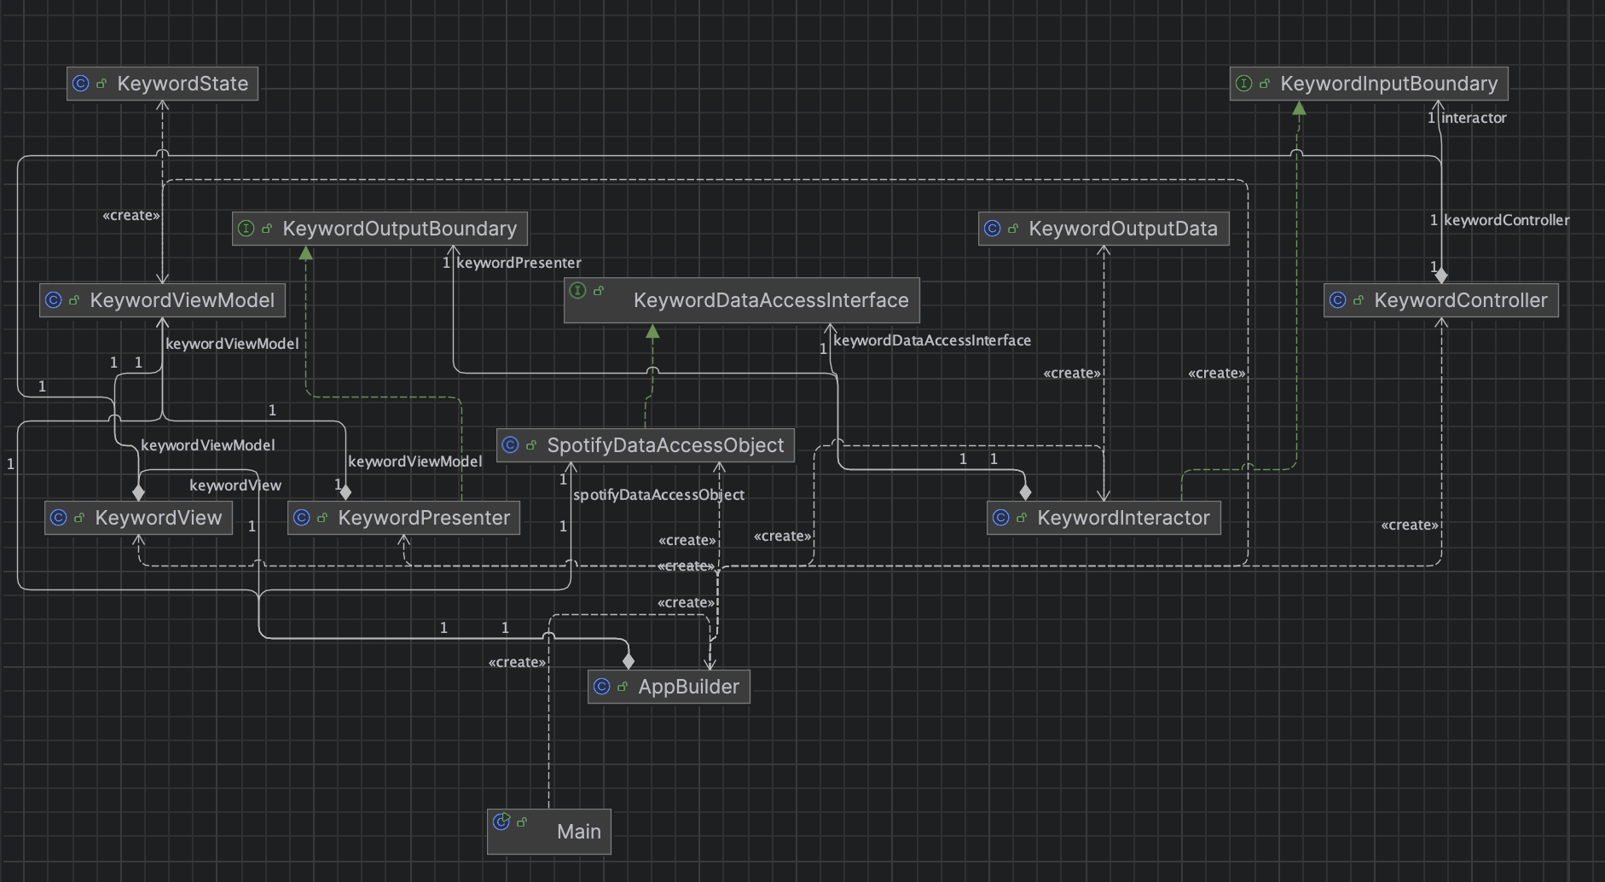
UML

Slide 15
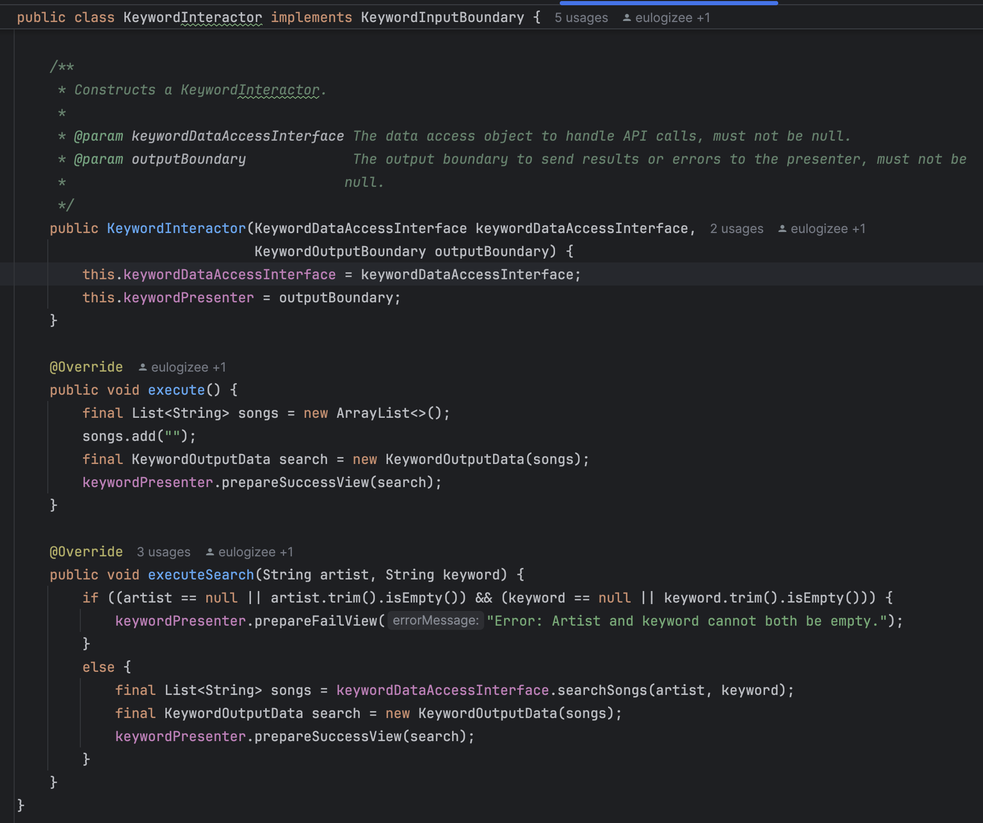
Keyword Interactor

Slide 16
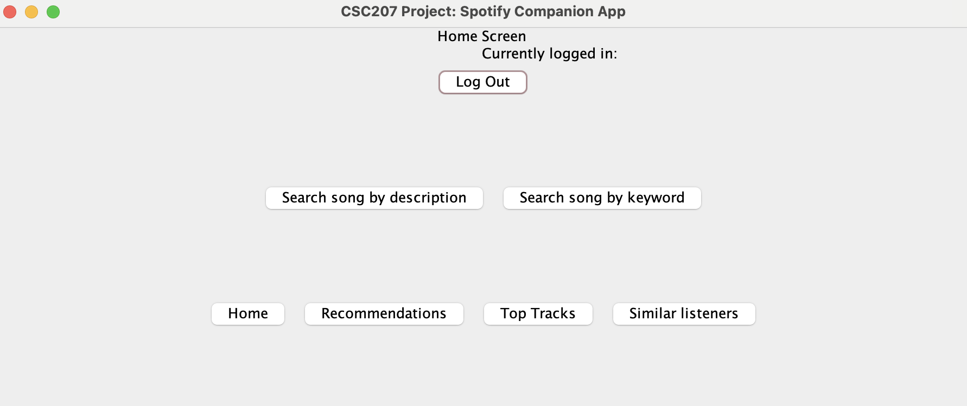
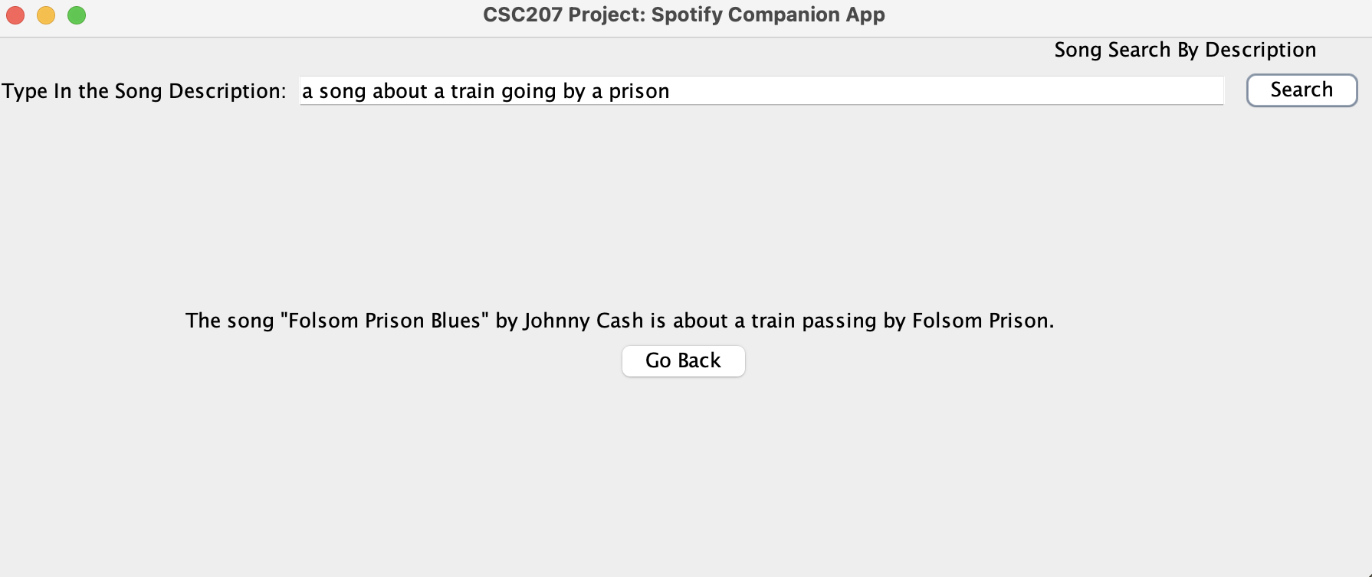
Description Search
User Story: John heard a song in public and can only remember a couple things about it, he would like to know what the song was.

Slide 17
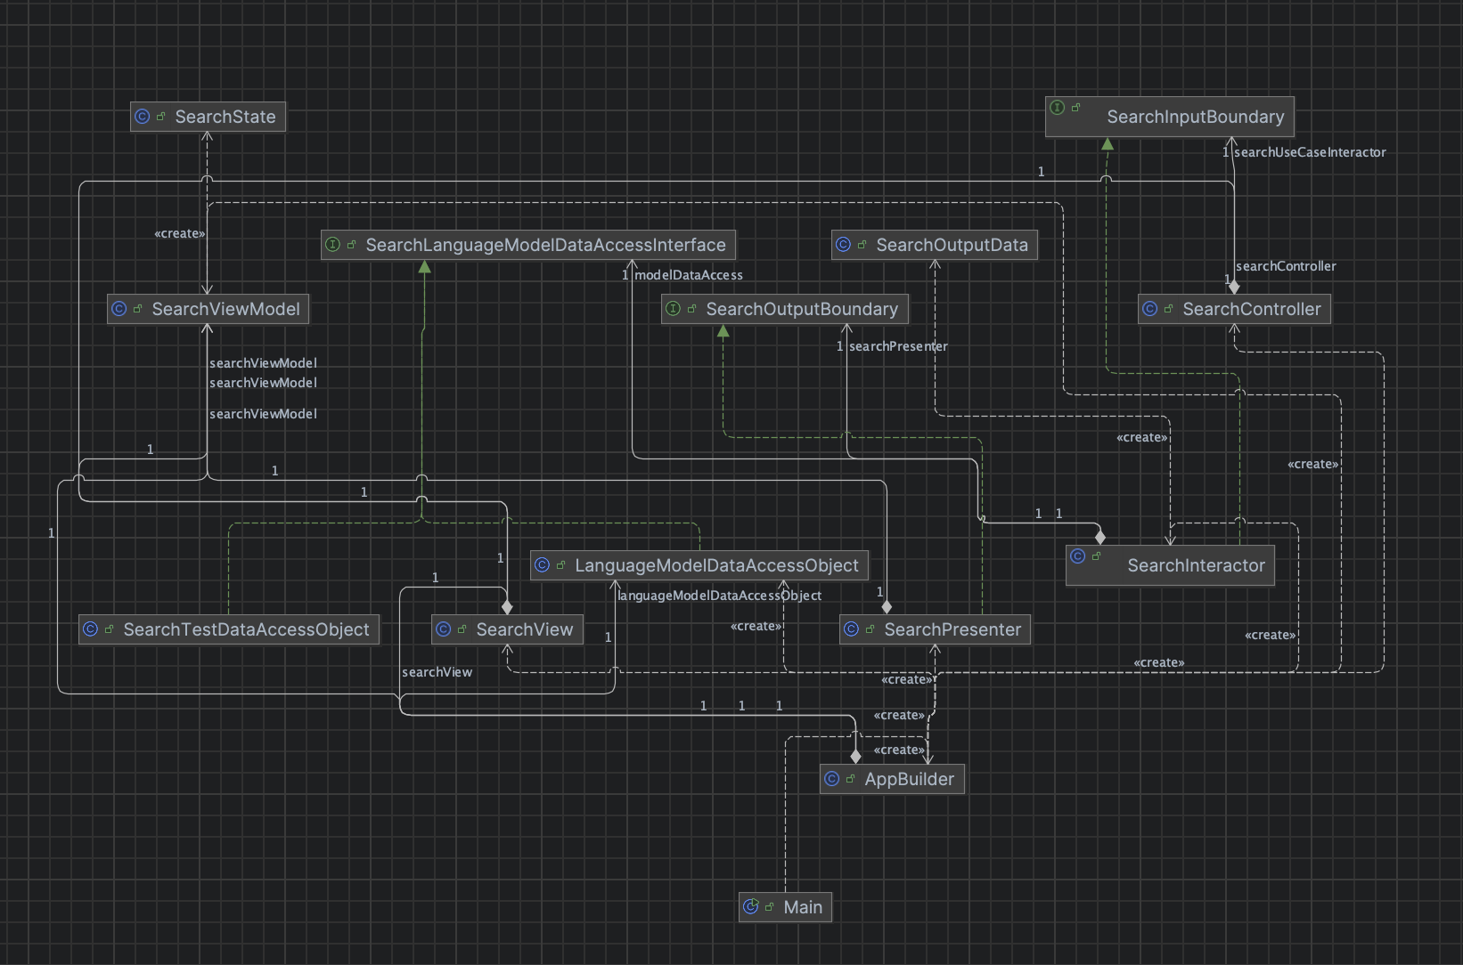
UML

Slide 18
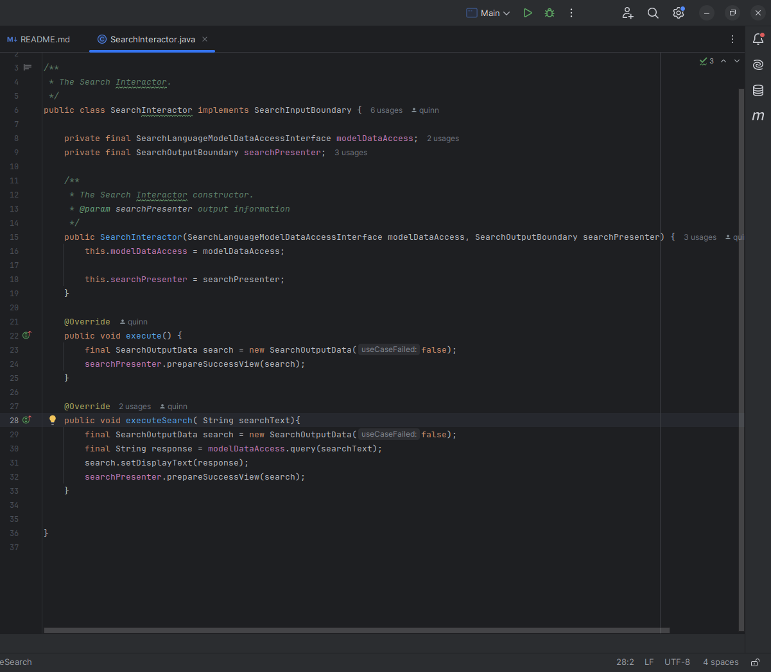
Description Search Interactor

Slide 19
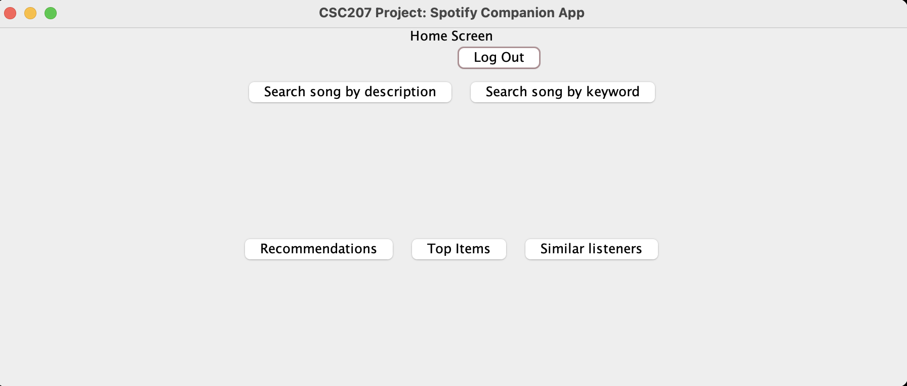
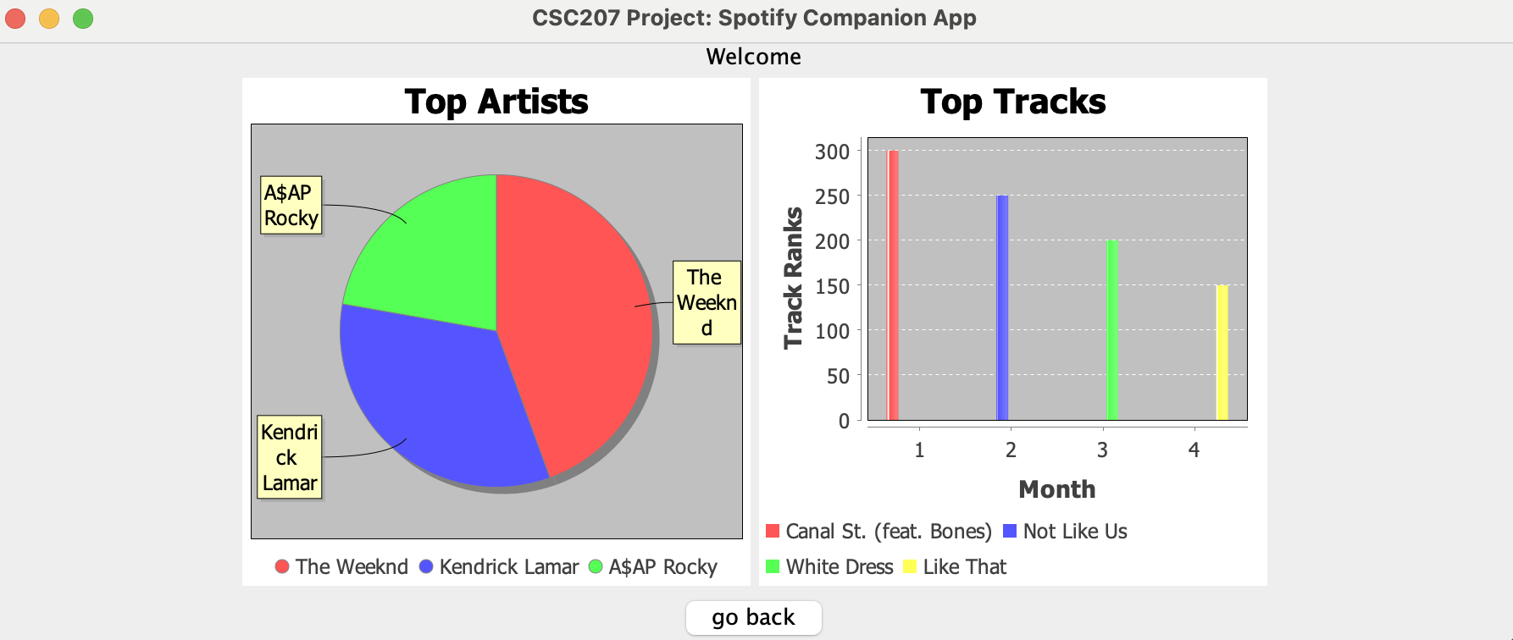
Top Tracks / Artists
User Story: John wants to see what his top tracks/artists are.

Slide 20
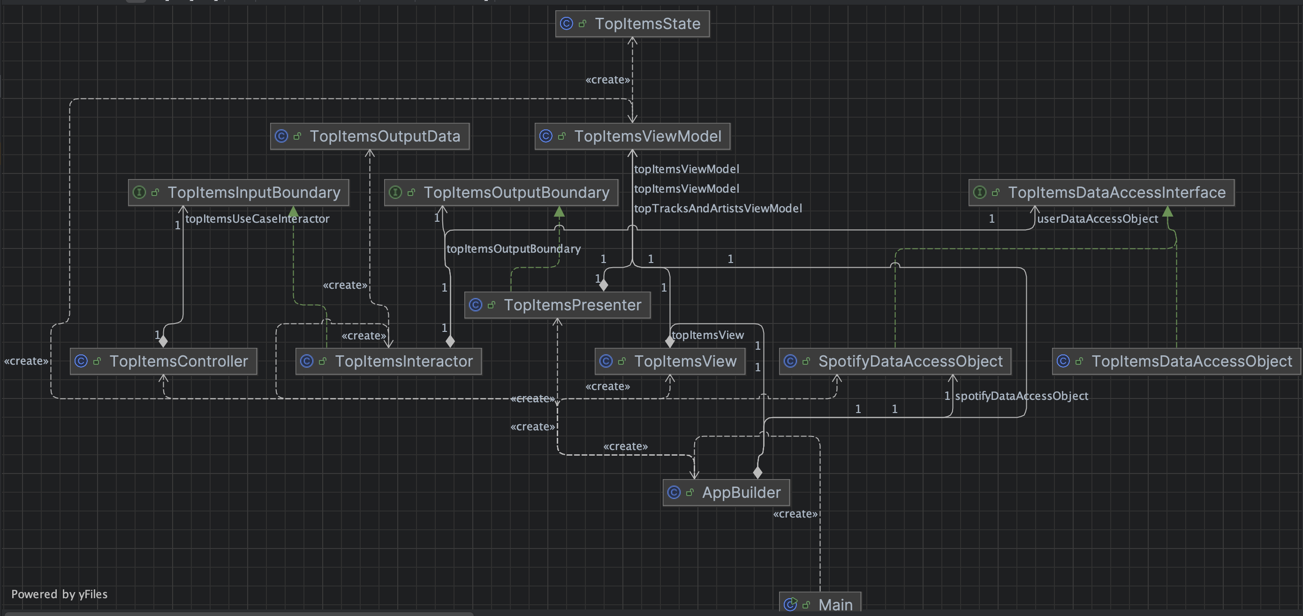
UML

Slide 21
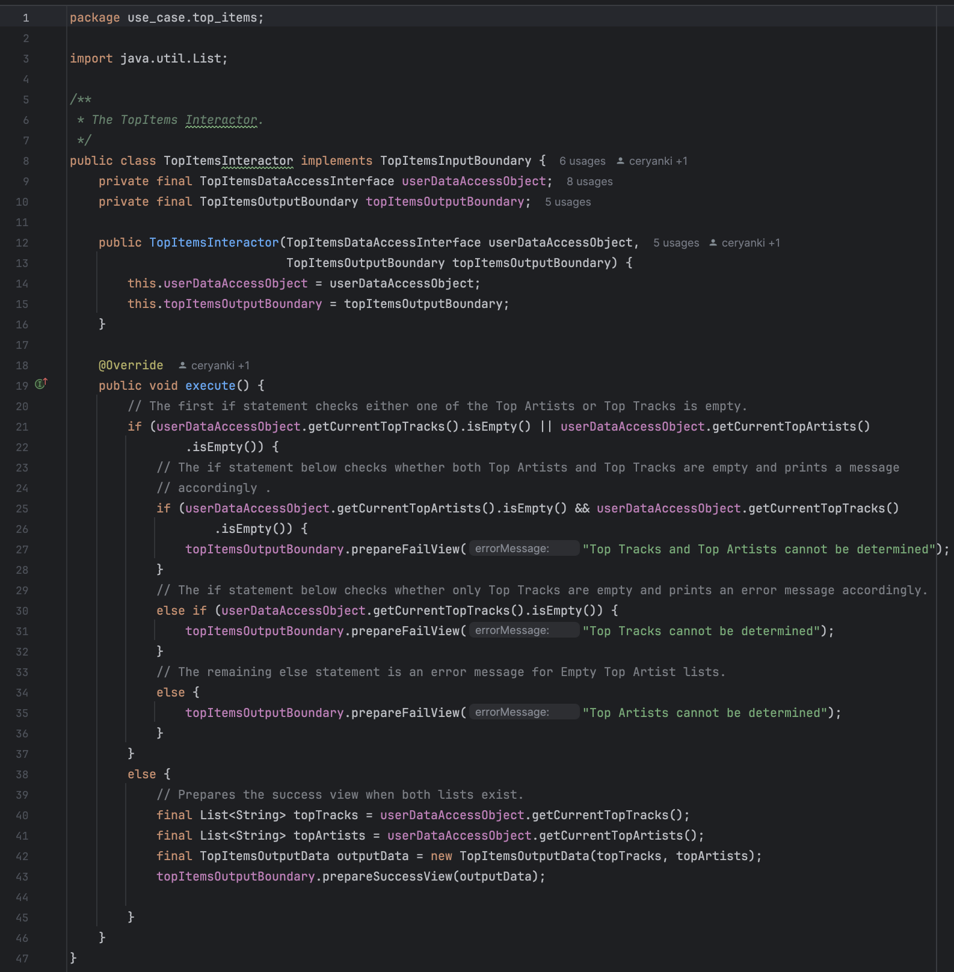
TopItems Interactor

Slide 22
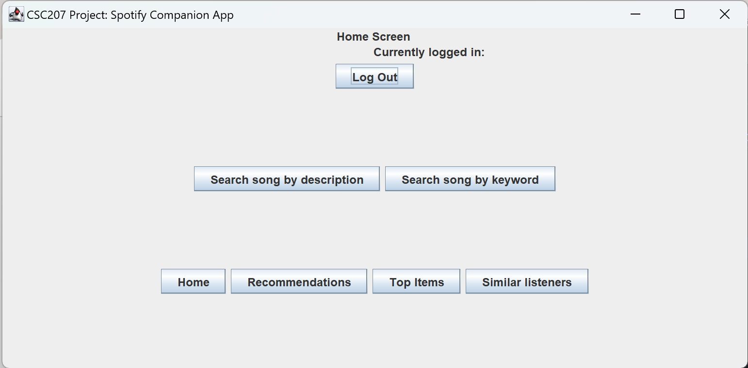
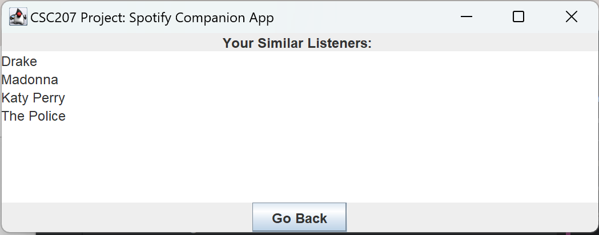
Similar Listeners
User Story: John wants to find other artists with a similar musical preference.

Slide 23
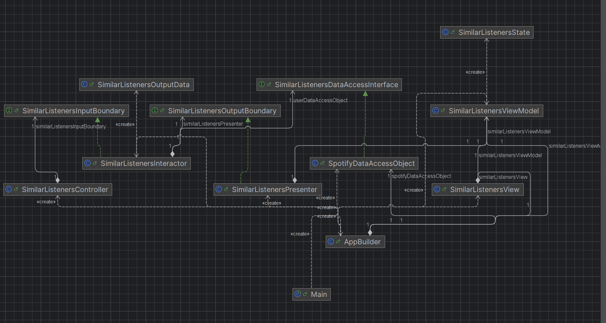
UML

Slide 24
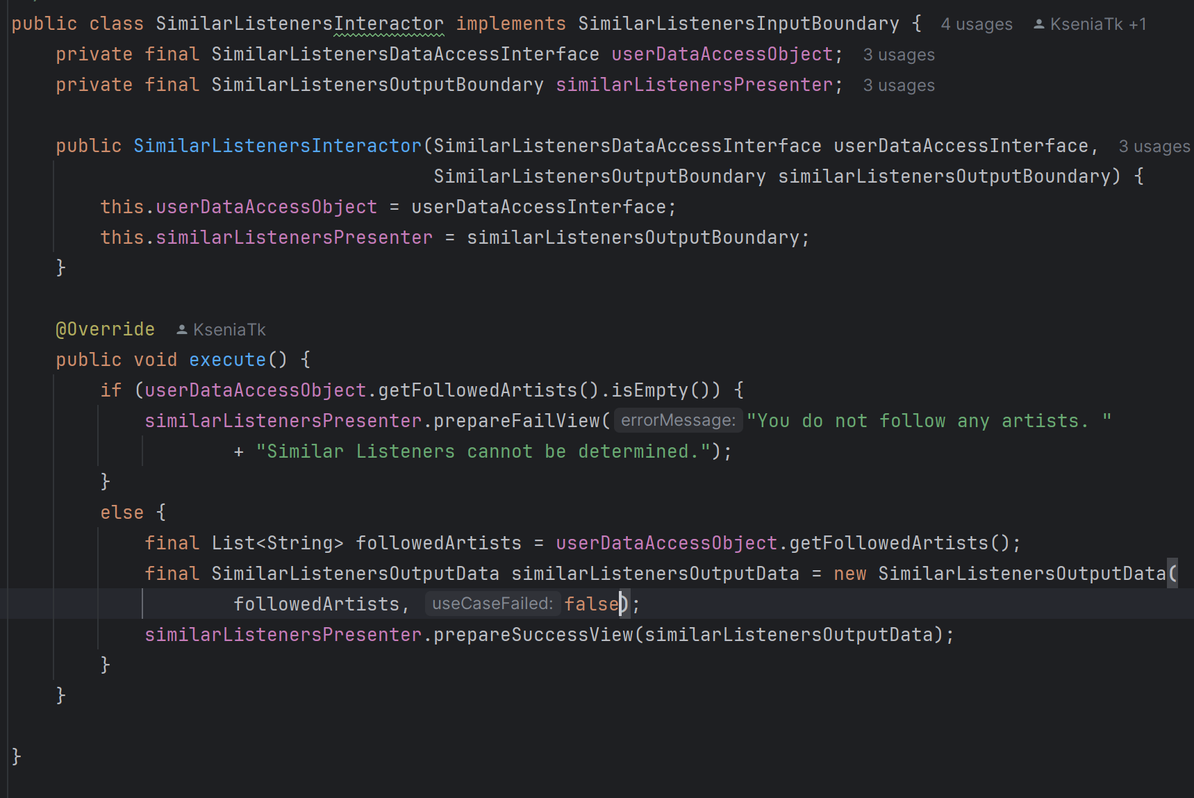
Similar Listeners Interactor

Slide 25
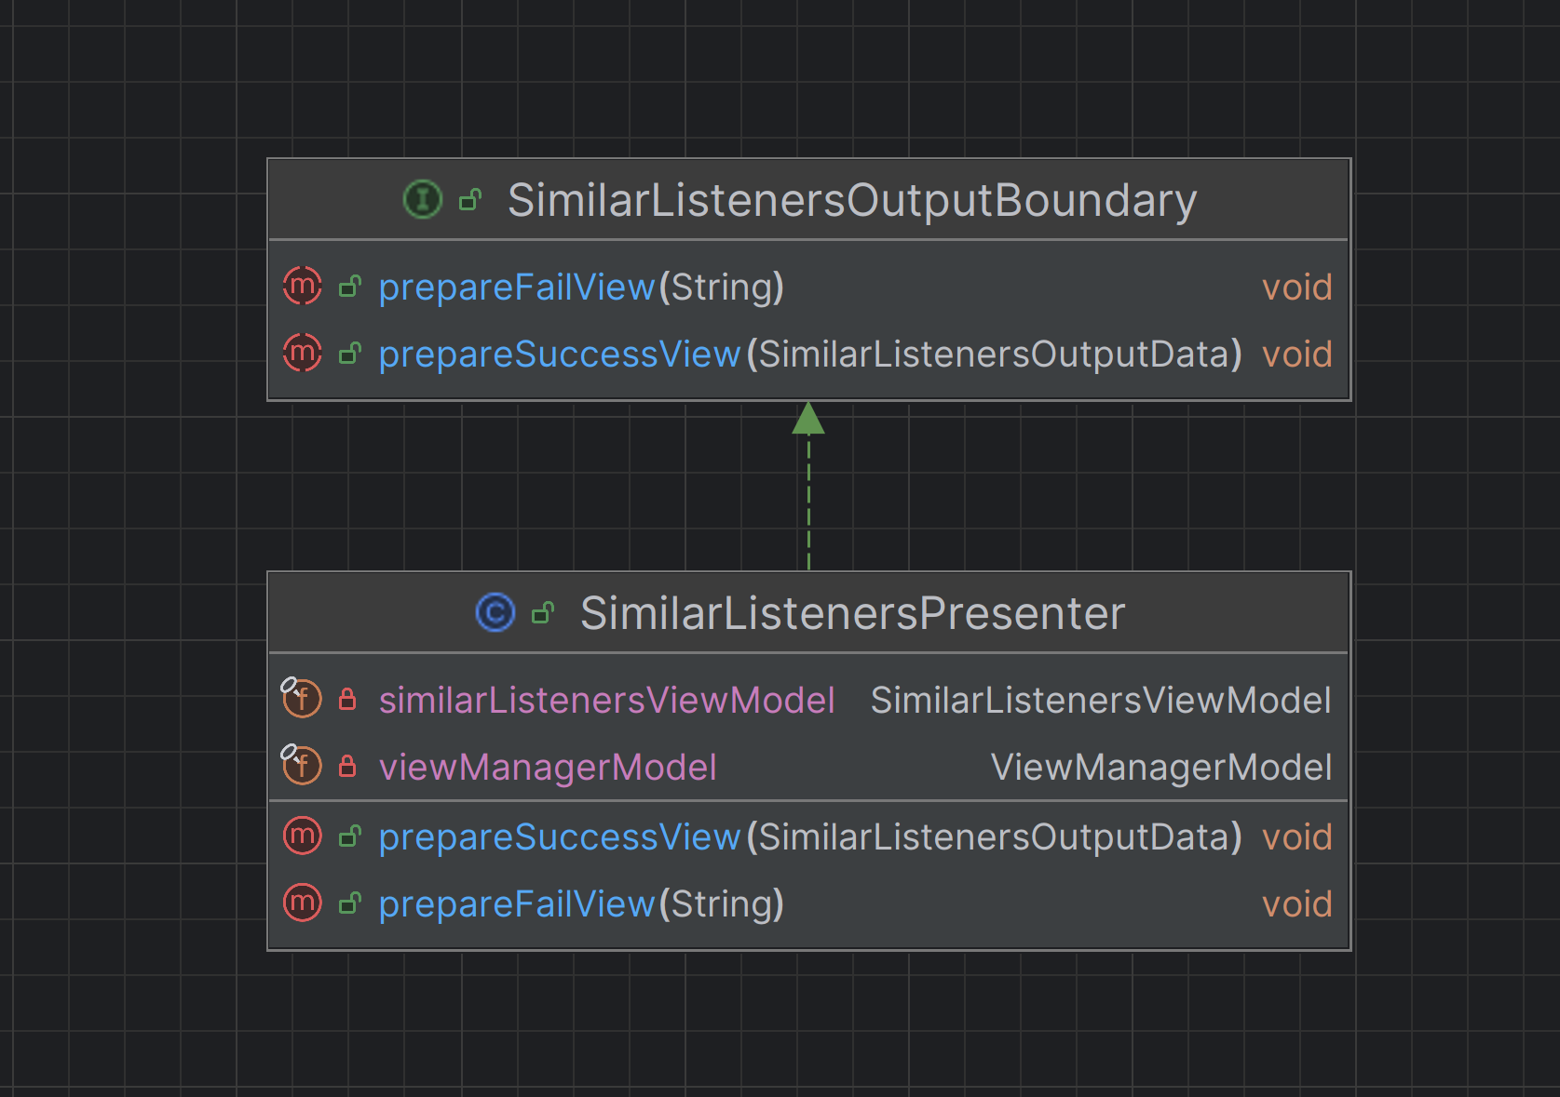
SOLID
Interface Segregation Principle:
Each of our interfaces for our use cases have a specific role and are connected to a specific use case, so all the methods in the interface are necessary and are implemented.
Example: Similar Listeners Output Boundary interface implemented by Similar Listeners Presenter.

Slide 26
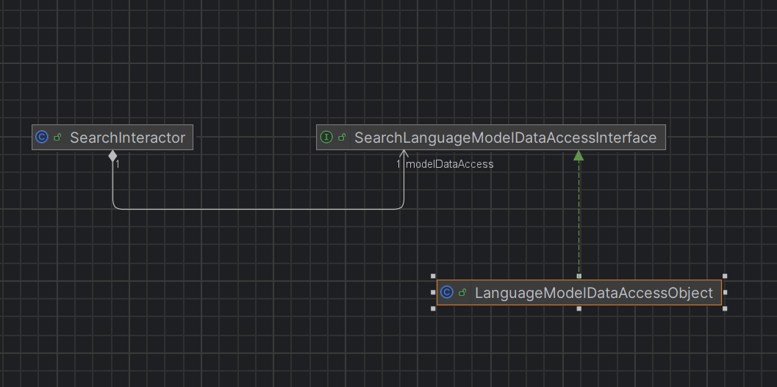
SOLID
Dependency Inversion Principle:
Each of our use case interactors depend on a data access interfaces rather on the low-level data access object.
Example, the Search Interactor depends on Search Language Model Data Access Interface which is implemented by the Language Model Data Access Object.

Slide 27
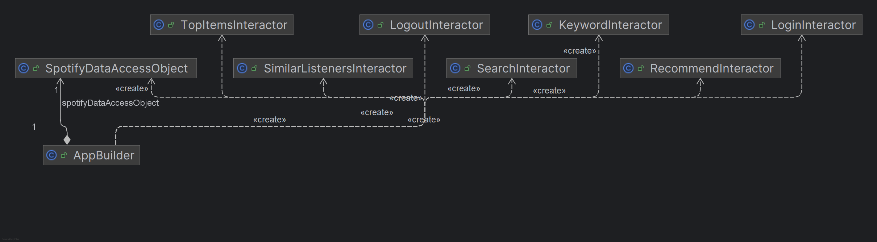
Design Patterns
In our project we implemented the Singleton Design Pattern, which ensures a class only has one instance which is passed through our project files. This pattern ensures classes are not implemented multiple times.

Slide 28

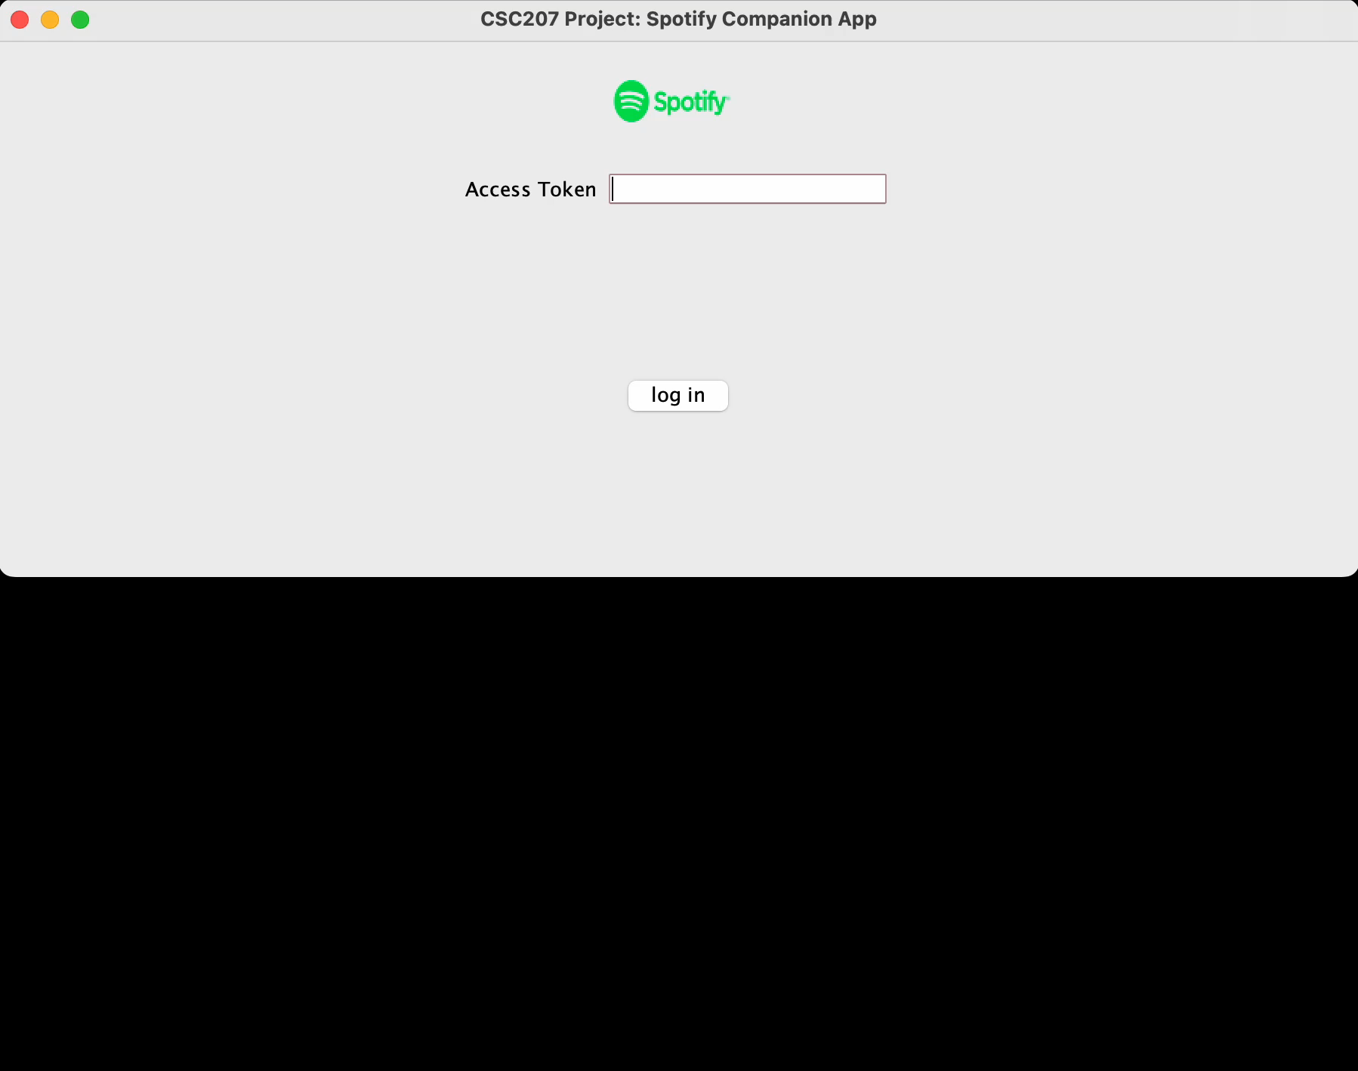


Functionality Demonstration

Slide 29
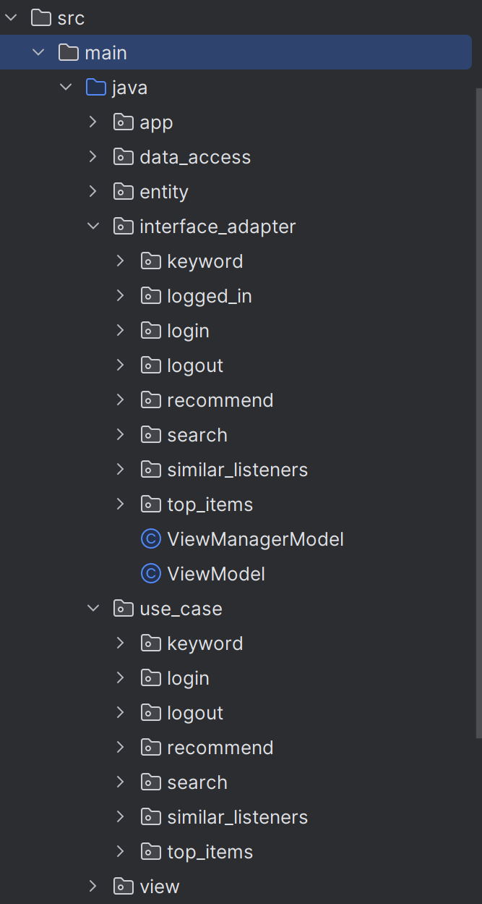
Code Organization
Used Inner/Outer package structure.

Slide 30
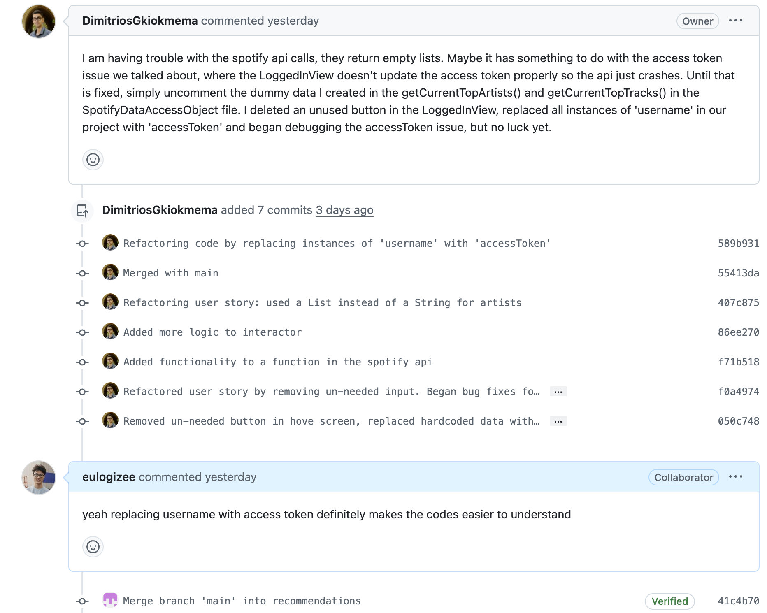
Code Quality
We used Checkstyle to make our code cleaner and clearer in terms of format.
Every time when we make a pull request, we clarify what are some major changes in this pull request so that the reviewer will grasp the key point of this pull request quickly. We also actively used the comment feature on Github to discuss questions and advice we have

Slide 31
Accessibility Report
Target Group: Spotify users with a high degree of computer literacy
Missed Groups: Those with lower computer literacy or those who don't use Spotify
Universal Principles of Design:
Size and Space For Approach and Use, all buttons are created to be the same size and the common home button is always at the bottom of the page
Tolerance for error, when the purpose of two buttons are very different, we placed them the further apart

Slide 32
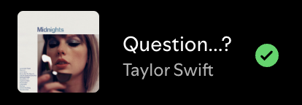


Question session

Slide 33
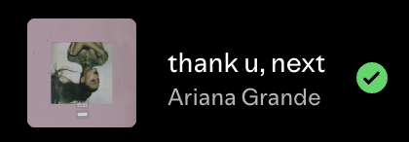

CSC207 Final Project Spotify Companion Fall 2024
Yanki Cer Dimitrios Gkiokmema Quinn Reynolds Ksenia Tkaczyk Yicheng Wang

